Slide 1







Thank you to our sponsors!
This event was powered by

Slide 2
Data Science made easier with azure machine learning studio
@datavibe

Slide 3



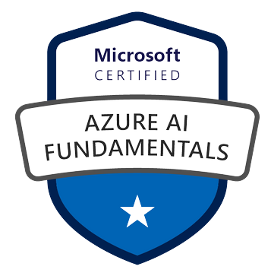





Pragati Jain
Microsoft Data Platform MVP
Superuser at Microsoft Power BI Community
10+ years of industry experience
Senior Data Analyst at Trustpilot, London
Fun Fact About Me:
I am a painter and proudly call myself ‘TechieArtist’ 😊
@datavibe

Slide 4

Agenda
Introduction to Azure Machine Learning Studio (Azure ML Studio)
Steps to create a simple no-code predictive algorithm using Azure ML Studio
Import a dataset
Explore data
Create a ML flow using different nodes
Look at Evaluation of the model
Look few performance metrics for the predictive algorithm
Resources to refer to start with Azure ML Studio
Q&A
@datavibe

Slide 5

What is Azure ML Studio?
“Azure ML Studio is a web portal that contains low-code and no-code options for creating a machine learning algorithm.”
Azure ML Studio is easy to use as:
It provides a no-code way of creating a ML algorithm
It provides a drag and drop interface
A little knowledge of data science concepts is enough to get started
Not just designed for Data Scientists but can be used by anyone interested in exploring how ML algorithms can be created with minimum effort
Easily accessible and scalable as it is in a secured cloud environment
@datavibe

Slide 6

Pre-requisites to get started
You are just few steps away from building your first machine learning model. Just make sure to have the following:
An Azure account is required with active subscription. Can be created here.
A free account gives you 12 months of free services with Azure credits for USD 200.
A Machine Learning workspace
A Compute Instance is needed – it is a like virtual machine pre-loaded with machine learning essentials, for you to start right away
A Compute Cluster is needed – it is required to perform machine learning computations
@datavibe

Slide 7
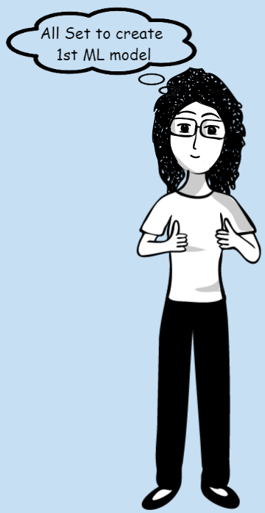
Let us create a simple ML model
We will be creating a simple Regression model using the Azure ML Studio.
Create a ML Resource
Launch Studio
Create a Compute Resource – To train a ML model using Azure ML Studio, we need a ‘compute’ for training and testing the model
A Compute Target is created to train and test the model along with running some exploratory analysis on the data
Compute Instance – this is a development instance which we will use to test the model
Compute Cluster – this is a cluster of VMs which we will use to train the model
@datavibe

Slide 8
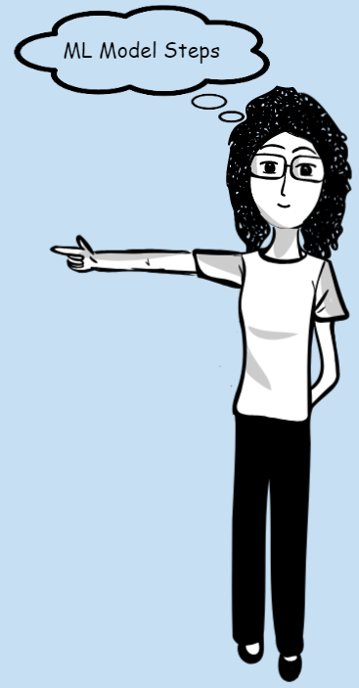
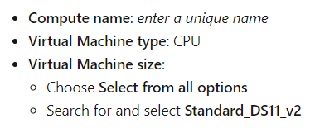
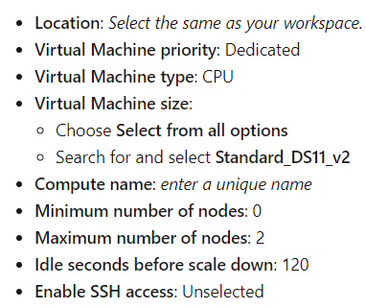
Let us create a simple ML model – Cont.
Compute Instance
Compute Cluster
@datavibe

Slide 9
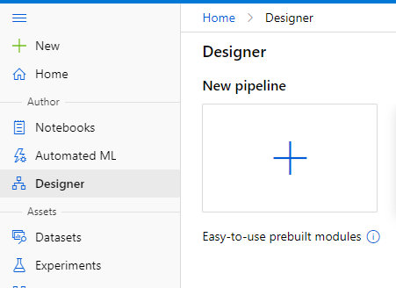
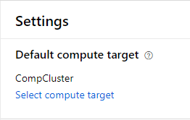
Let us create a simple ML model – Cont.
Create Pipeline: To train a ML model in the Azure ML Designer, we need a pipeline
@datavibe

Slide 10
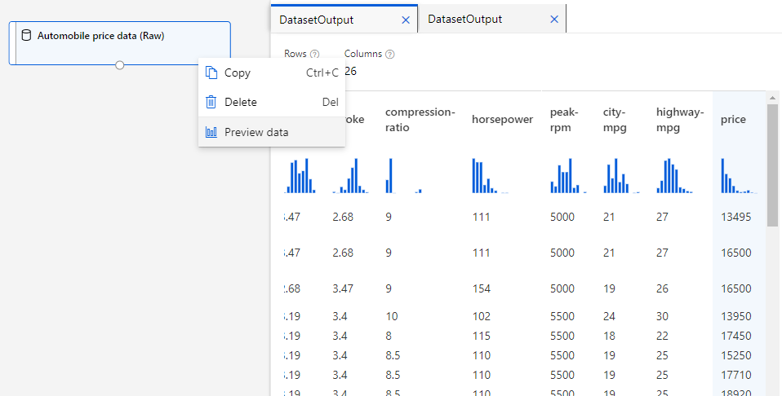
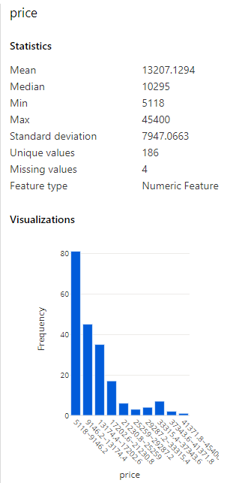
Explore data
We will try to predict the price of an automobile using the automobile price data based on the characteristics. We will be training a basic regression model to predict a numeric value.
Label to predict
@datavibe

Slide 11

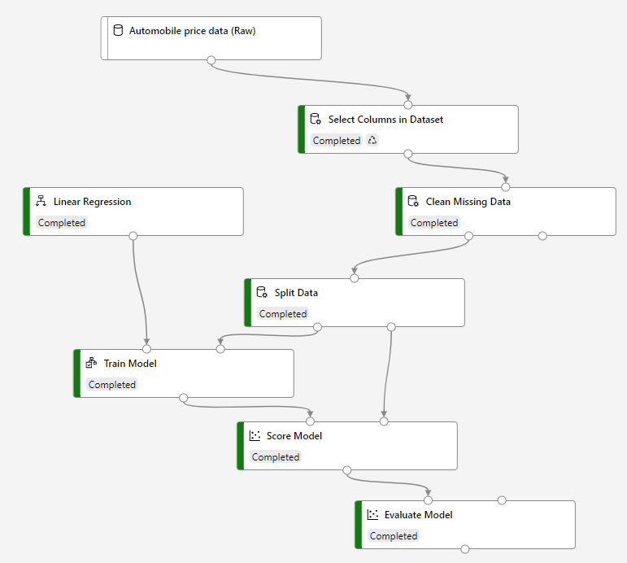
Final flow diagram of a the ml model
@datavibe

Slide 12

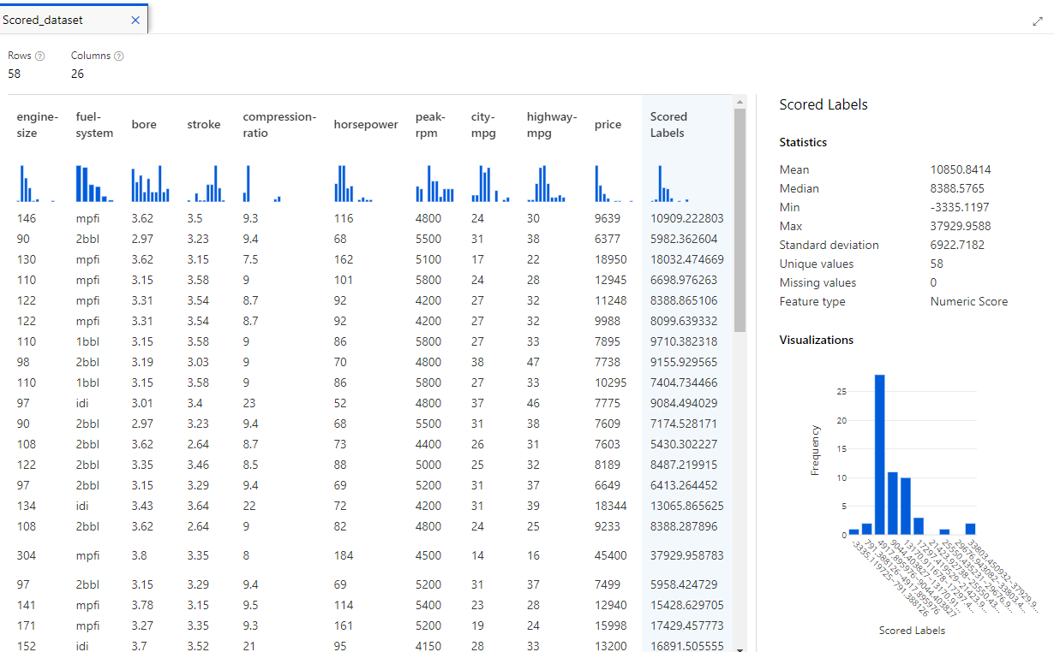
Model Scoring
Scored labels are the predicted labels
@datavibe

Slide 13

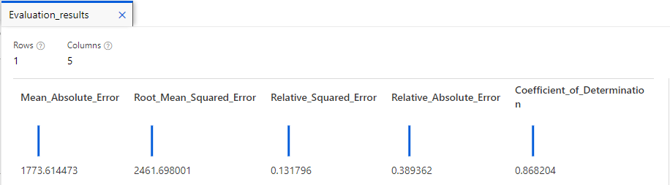
Model evaluation
Diff. between actual & predicted: Lower the value, better is model performance
Square root of mean squared Diff. between actual & predicted
Relative metric: Square of Diff. between actual & predicted (0 to 1): Closer the value to 0, model performance is better
Relative metric: Absolute Diff. between actual & predicted (0 to 1): Closer the value to 0, model performance is better
Variance between predicted & true values: Closer the value to 1, model performance is better
@datavibe

Slide 14

Clean up resources
Go to Compute area and stop your compute instances. (this will ensure you are not charged on your Azure subscription for these services)
Delete your machine learning resource if you don’t want to use it.
If you decide to keep it, you may be charged a small amount to keep the data storage area for this resource.
If you don’t intend to use these services further, you can also delete them.
@datavibe

Slide 15
Resources to help your learning
Microsoft official documentation -
Resource1
Resource2
Resource3
Data Science Basic Concepts –
Reference1
Reference2
Reference3
Reference4
Take Azure AI-900 Fundamentals certification to boost your confidence – Learning Paths
@datavibe

Slide 16

Thank you and Happy to answer any questions.
@datavibe

